Slide 1
ants can colour graphs
(or so I’m told)

Slide 2
Graph (vertex) colouring
the problem
  assign a colour to every vertex in a graph such that no adjacent vertices have the same colour
more formally…
  given: a graph G={V,E}
  find: a map c:V → S such that c(v) ≠ c(w) where v and w are adjacent vertices

Slide 3
Graph (vertex) colouring cont.
S is the set of available colours
  want to minimize the size of S
  if G has a set S of size q, this is called a q-colouring of G
n is the number of vertices in G
easy to find a q-colouring of G
  just pick q = n

Slide 4
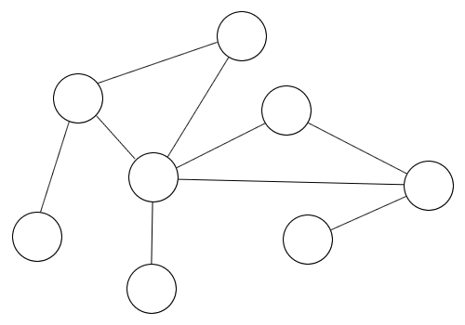
GC example

Slide 5
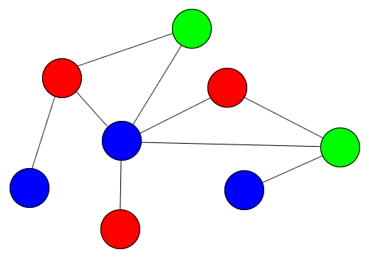
GC example

Slide 6
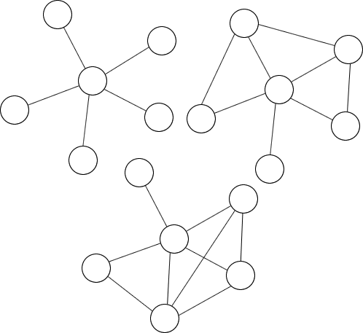
GC example

Slide 7
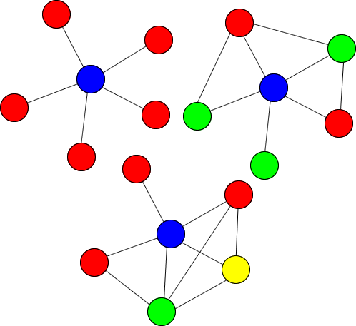
GC example

Slide 8
GC note
notice that the smallest q-colouring is equal to the size of the largest clique of G
  this has nothing to do with anything that will follow
  it’s just an interesting observation and a lower bound on the size of q

Slide 9
Why colour graphs?
good question (glad you asked…)
it’s useful for
  assignment type problems
    frequency assignment to radio stations
    register allocation in compilers
  scheduling
    timetabling for exams

Slide 10
So what’s the problem?
graph colouring is NP-hard
  can prove this by reduction to 3-SAT
    not going to do it now though
  intuitively,
    max_clique is NP-hard
    max_clique defines the lower bound for minimum q-colouring
    therefore GC seems it should be NP

Slide 11
GC exact solution
Exhaustive search
  enumerate all possible combinations
  guaranteed to find smallest q
  not guaranteed to complete in your lifetime

Slide 12
GC heuristics
graph colouring is a much loved, well-worn problem
many heuristics have been applied
    neural nets
    maximum independent set
    simulated annealing
    TABU search
    evolutionary simulated annealing

Slide 13
GC heuristics cont.
simple greedy algorithm
  for each vertex v
    colour v’s neighbours with any colour not already on their neighbours
  this is fast
  produces solutions bounded by
    MAX_degree(G) + 1
  quality of solution depends on vertex visit order
    pick highest degree vertices first
  can be easily improved by backtracking

Slide 14
GC heuristics cont.
Degree of Saturation (DSAT)
  same as greedy except…
    initial v is arbitrary (random or some rule)
    subsequent v has maximum coloured neighbourhood.
      if more than one max, decide arbitrarily
  still fast
  better than greedy

Slide 15
GC heuristic cont.
Recursive Largest First (RLF)
  while there are still vertices to colour
    choose a colour i
    make a list U of uncoloured vertices
    while U isn’t empty
      find v with most uncoloured neighbours and colour it i
      remove v and all its neighbours from U
  still fast
  also better than greedy

Slide 16
GC ant heuristic
ANTCOL
ant colony colouring
  proposed in “Ants can colour graphs”
    D. Costa; A.Hertz
    1997

Slide 17
ANTCOL overview
given a graph G with n vertices
each individual ant wanders the graph
  applies a colour to each vertex as it goes
  uses a standard incremental heuristic
  vertex choice based on a probabilistic combination of pheromone trail and heuristic

Slide 18
ANTCOL pheromone
after colouring the graph
  pheromone collects in an nxn matrix M
  values in M represent the quality of solutions found when 2 vertices have the same colour
  or, more formally…
    given: vertices v_{r},v_{s} M_{rs} is proportional to q when c(v_{r}) = c(v_{s})

Slide 19
ANTCOL pheromone
M is updated as follows
  M_{rs} = ρ.M_{rs} + ∑ 1/q_{a}
  where
    ρ = rate of evaporation
    num_ants ≥ a ≥ 1
    s_{a} = solution found by ant a
    S_{rs} = all solutions where c(v_{r}) = c(vs)
s_{a} ∈ S_{rs}

Slide 20
ANTCOL transition
Costa and Hertz define a generic transition rule, similar to TSP and VC, for all assignment problems
essentially the probability of giving a vertex a colour is
  prob = trail_factor^{α}.heuristic_preference^{β}
α and β give weights to the trail and heuristic probabilities respectively
________
sum of all (trail_factor^{α}.heuristic_preference^{β}) so far
Notes:
the denominator of this equation is essentially an estimate of how good the colouring has been so far (using previous runs to gauge its quality)

Slide 21
ANTCOL transition
given a partial solution s[k-1] the trail factor calculation is provided by
1
if V_{c} is empty
∑
M_{xv}
τ₂(s[k - 1], v, c) :=
x∈V_{c}
____
otherwise
|V_{c}|

Slide 22
ANTCOL heuristics
chose 2 simple heuristics for ANTCOL
RLF
  optimal configuration
    random initial vertex
    heuristic preference is degree(v)
DSATUR
  optimal configuration
    heuristic preference is dsat(v)
    always choose lowest colour for v
Notes:
in preference to random and simple greedy

Slide 23
ANTCOL trials
chose
  α ∈ {1,2}, β = 4, ρ=0.5, iterations = 50
  by trial and error
ran against random graphs, generated with a statistical proportion of connected vertices
  p = {0.4, 0.5, 0.6}

Slide 24
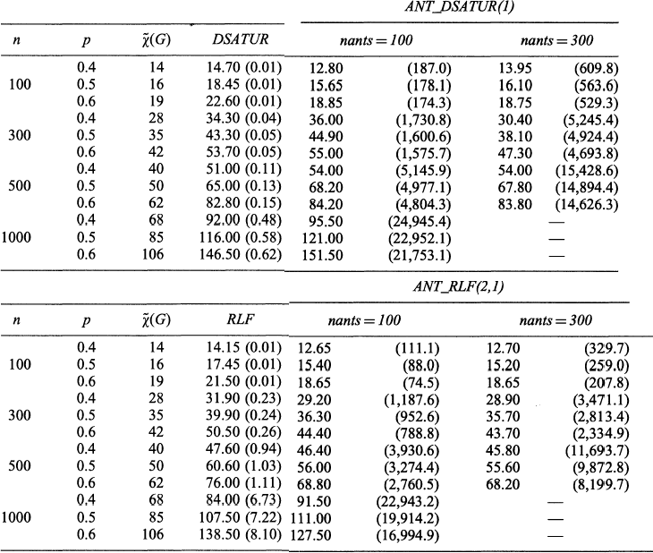
ANTCOL results

Slide 25
ANTCOL results
overall, over 50 iterations of ANTCOL
  ANT_RLF better than ANT_DSATUR
  both better than RLF and DSATUR
    but slower
  ANTCOL produced better results than the heuristics compared against…
    … but it took a really long time to execute…
    … and there are still algorithms out there that work better than it

Slide 26
ANTCOL results
In particular,
  # ants is important
    < n, is unsatisfactory
    for small (n = 100) graphs, ANT_DSATUR worked better with 100 ants
      (sometimes less is more)

Slide 27
ANTCOL under scrutiny
ANTCOL algorithm doesn’t scale well
  up to 2000x slower than other heuristics for 10% reduction in q
  use of ANTCOL would depend on time-accuracy trade-off
  authors suggest ANTCOL would perform better on MIMD hardware
    other heuristics would probably also receive a performance boost on such hardware

Slide 28
ANTCOL under scrutiny
“How good can ants color graphs?”
  Vesel and Zerovnik
seem to have taken offence at Hertz and Costa’s results
  argue that comparison between ANTCOL and DSAT/RLF invalid
  ANTCOL performs 50 X nants iterations of DSAT/RLF as subroutines (vs. 50 iterations of DSAT/RLF alone)
  therefore comparison should be against 50 x nants iterations of DSAT/RLF

Slide 29
ANTCOL under scrutiny
test re-run by Vesel, Zerovnik
used 50 x nants iterations
  concluded that ANT_RLF beats repeated_RLF
  repeated_RLF beats ANT_DSAT
  Petford-Welsh algorithm beats all
    incremental multi-pass colour assignment algorithm… I think
    hard to find a good description
Notes:
Petford-Walsh does something like… colours all nodes a colour in one pass. Finds the problems and then colours those ones a different colour. Then it repeats.

Slide 30
Can ants colour graphs?
“ACODYGRA: An agent algorithm for coloring dynamic graphs”
  Preuveneers and Berbers
  dynamic graph ant algorithm
  concluded that agents just aren’t as good as other algorithms for graph colouring
so the answer is… yes!
  but generally not as well as other things do

Slide 31
fin.

Slide 32
References
Ants can colour graphs
  D. Costa; A. Hertz
  The Journal of the Operational Research Society, Vol. 48, No. 3 (Mar., 1997)
Graph Theory
  Reinhard Diestel
  Springer-Verlag, New York, 2000
ACODYGRA: An agent algorithm for coloring dynamic graphs
  D. Preuveneers; Yolande Berbers
  K.U. Leuven

Slide 33
References cont.
Graph coloring algorithms
  Walter Klotz
  Mathematik-Bericht 5 (2002), 1-9, TU Clausthal
A multi-agents approach for a graph colouring problem
  B. Mermet; G. Simon; M.Flouret
  2002
An evolutionary annealing approach to graph colouring
  D. A. Fotakis; S. D. Likothanassis; S.K. Stefanakos

